Slide 1
Construct MUX and DEMUX using NAND gates and other gates

Slide 2
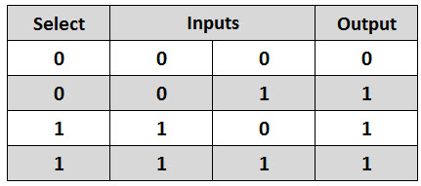
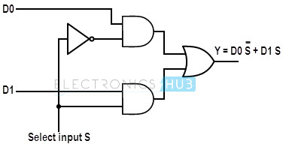
MUX(multiplexer)
In electronics, a multiplexer (or mux) is a device that selects between several analog or digital input signals and forwards it to a single output line.

Slide 3
MUX using NAND gates

Slide 4
IC Required : 7400(Nand Gate)

Slide 5
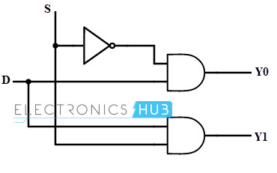
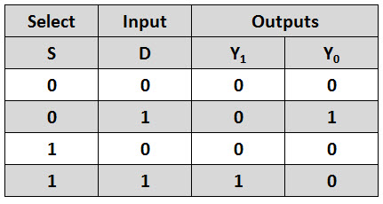
Demux(De-multiplexer)
The action or operation of a demultiplexer is opposite to that of the multiplexer. As inverse to the MUX , demux is a one-to-many circuit. With the use of a demultiplexer , the binary data can be bypassed to one of its many output data lines.

Slide 6
DEMUX using NAND gates
Select | Input | Output A | Output B
0 | 0 | 0 | 0
0 | 1 | 1 | 0
1 | 0 | 0 | 0
1 | 1 | 0 | 1

Slide 7
IC Required : 7400(Nand Gate)

Slide 8
Thank You...

